Slide 1
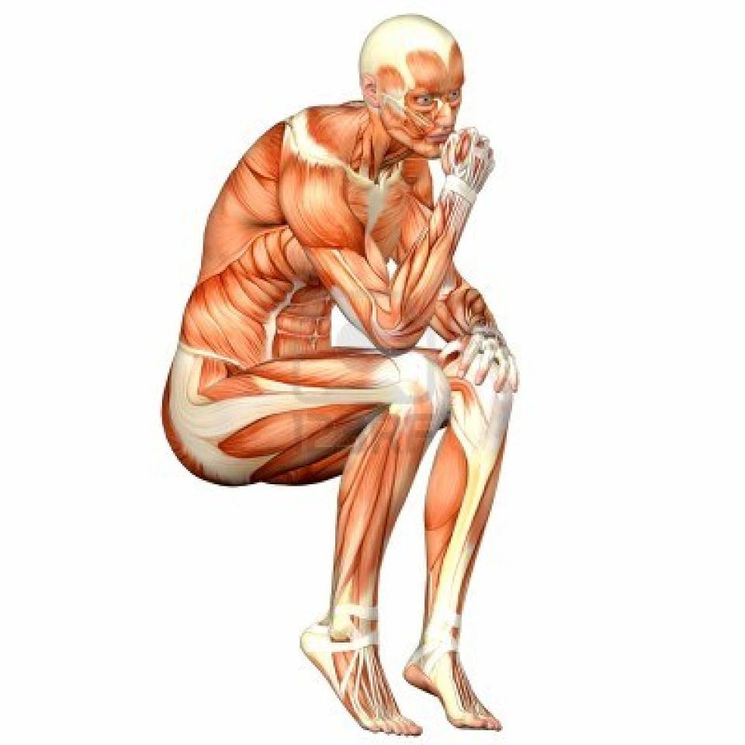
Human body

Slide 2
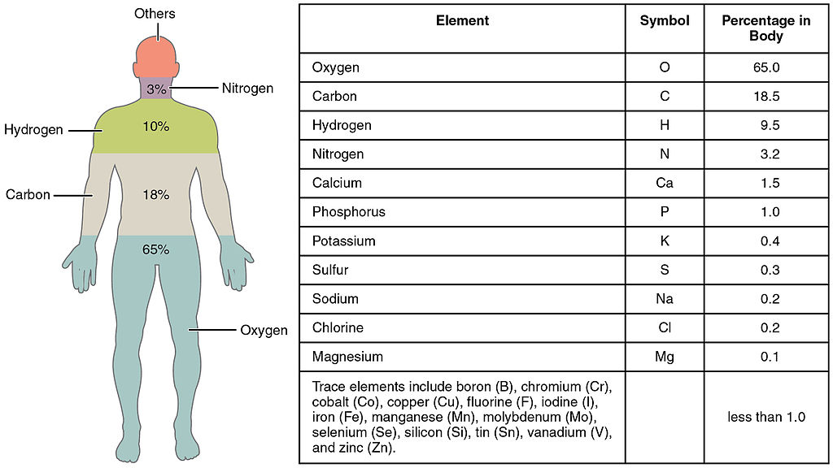
The human body
The human body is the entire structure of a human being and comprises a head, neck, trunk (which includes the thorax and abdomen), arms and hands, legs and feet. Every part of the body is composed of various types of cell.[1] At maturity, the estimated number of cells in the body is given as 37.2 trillion. The composition of the human body shows it to be composed of a number of certain elements, such as Ca2+, Na+, K+, C, etc, in different proportions.

Slide 3
The study of the human body involves Anatomy and Physiology. The human body can show anatomical non-pathological anomalies which need to be able to be recognized. Physiology focuses on the systems and their organs of the human body and their functions. Many systems and mechanisms interact in order to maintain homeostasis.

Slide 4
Human anatomy is primarily the scientific study of the morphology of the human body. Anatomy is subdivided into gross anatomy and microscopic anatomy. Gross anatomy is the study of anatomical structures that can be seen by the naked eye. Microscopic anatomy involves the use of microscopes to study minute anatomical structures, and is the field of histology which studies the organization of tissues at all levels, from cell biology (previously called cytology), to organs.

Slide 5
Five sences
A sense is a physiological capacity of organisms that provides data for perception.
A system that consists of a group of sensory cell types that responds to a specific physical phenomenon, and that corresponds to a particular group of regions within the brain where the signals are received and interpreted

Slide 6
Sight or vision is the capability of the eye(s) to focus and detect images of visible light on photoreceptors in the retina of each eye that generates electrical nerve impulses for varying colors, hues, and brightness.
Hearing or audition is the sense of sound perception.
Taste refers to the capability to detect the taste of substances such as food, certain minerals, and poisons, etc.
Smell or olfaction is the other "chemical" sense. Unlike taste, there are hundreds of olfactory receptors (388 according to one source), each binding to a particular molecular feature.
Touch or somatosensation, also called tactition or mechanoreception, is a perception resulting from activation of neural receptors, generally in the skin including hair follicles, but also in the tongue, throat, and mucosa.

Slide 9
Anatomical position
These standardized terms avoid confusion. Examples of terms include:
Anterior and posterior, which describe structures at the front (anterior) and back (posterior) of the body. For example, the toes are anterior to the heel, and the popliteus is posterior to the patella.
Superior and inferior, which describe a position above (superior) or below (inferior) another part of the body. For example, the orbits are superior to the oris, and the pelvis is inferior to the abdomen.
Proximal and distal, which describe a position that is closer (proximal) or further (distal) from the trunk of the body. For example, the shoulder is proximal to the arm, and the foot is distal to the knee.

Slide 10
Superficial and deep, which describe structures that are closer to (superficial) or further from (deep) the surface of the body. For example, the skin is superficial to the bones, and the brain is deep to the skull. Sometimes profound is used synonymously with deep.
Medial and lateral, which describe a position that is closer to (medial) or further from (lateral) the midline of the body. For example, the nose is medial to the eyes, and the thumb is lateral to the other fingers.
Ventral and Dorsal, which describe structures derived from the front (ventral) and back (dorsal) of the embryo, before limb rotation.
Cranial and caudal, which describe structures close to the top of the skull (cranial), and towards the bottom of the body (caudal).

Slide 12
Planes
The sagittal plane is the plane that divides the body or an organ vertically into right and left sides.
The frontal plane is the plane that divides the body or an organ into an anterior (front) portion and a posterior (rear) portion. The frontal plane is often referred to as a coronal plane.
The transverse plane is the plane that divides the body or organ horizontally into upper and lower portions. Transverse planes produce images referred to as cross sections.

Slide 15
Movemnts

Slide 16
General motion
Flexion and Extension, which refer to a movement that decreases (flexion) or increases (extension) the angle between body parts. For example, when standing up, the knees are extended.
Abduction and adduction refers to a motion that pulls a structure away from (abduction) or towards (adduction) the midline of the body or limb. For example, a star jump requires the legs to be abducted.
Internal rotation (or medial rotation) and External rotation (or lateral rotation) refers to rotation towards (internal) or away from (external) the center of the body. For example, the asana posture in yoga requires the legs to be externally rotated.
Elevation and Depression refers to movement in a superior (elevation) or inferior (depression) direction. For example, a person saluting must elevate their arm

Slide 17
Special motions of the hands and feet
Dorsiflexion and Plantarflexion refers to flexion (dorsiflexion) or extension of the foot at the ankle. For example, plantarflexion occurs when pressing the brake pedal of a car.
Palmarflexion and dorsiflexion refer to movement of the flexion (palmarflexion) or extension (dorsiflexion) of the hand at the wrist. For example, prayer is often conducted with the hands dorsiflexed.
Pronation and Supination refer to rotation of the forearm or foot so that in the anatomical position the palm or sole is facing anteriorly (supination) or posteriorly (pronation) rotation of the forearm. For example, a person skiing must pronate their arms in order to grasp the skis.
Eversion and Inversion refer to movements that tilt the sole of the foot away from (eversion) or towards (inversion) the midline of the body.

Slide 18
Anterograde and Retrograde flow, refers to movement of blood or other fluids in a normal (anterograde) or abnormal (retrograde) direction.
Protraction and Retraction refer to an anterior (protraction) or posterior (retraction) movement of the arm at the shoulders.
Circumduction refers to the circular movement of a body part, such as a ball-and-socket joint or the eye. It consists of a combination of flexion, extension, adduction, and abduction. "Windmilling" the arms or rotating the hand from the wrist are examples of circumductive movement.
Opposition – A motion involving a grasping of the thumb and fingers.
Reposition – To release an object by spreading the fingers and thumb.
Reciprocal motion of a joint – Alternating motion in opposing directions, such as the elbow alternating between flexion and extension.
Protrusion and Retrusion are sometimes used to describe the anterior (protrusion) and posterior (retrusion) movement of the jaw.

